Slide 1
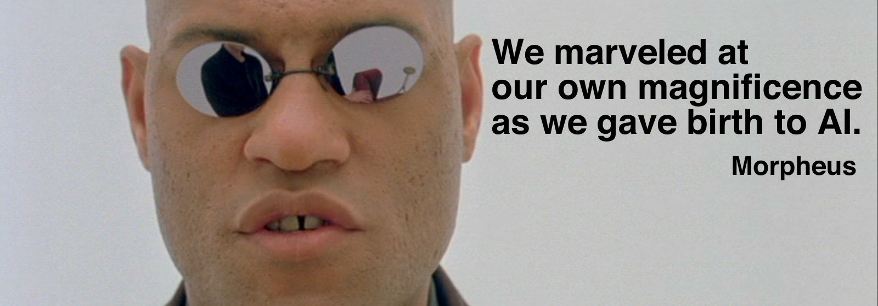
Let’s talk about chatGPT

Slide 2
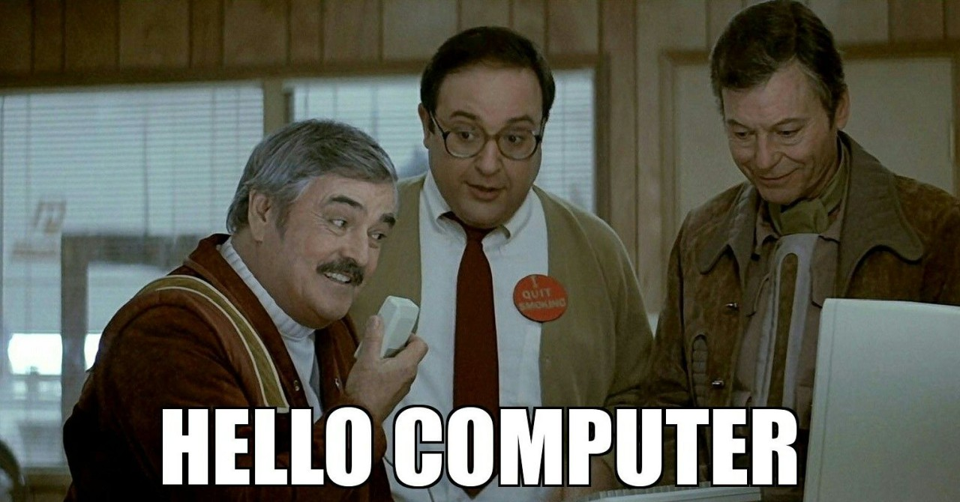
Technology Breeds Change

Slide 3

The “chat” of chatGPT
Tell me about…
?
Do all of my work
Good
Bad
Basically a search engine
Constructive use
Plagiarism

Slide 4
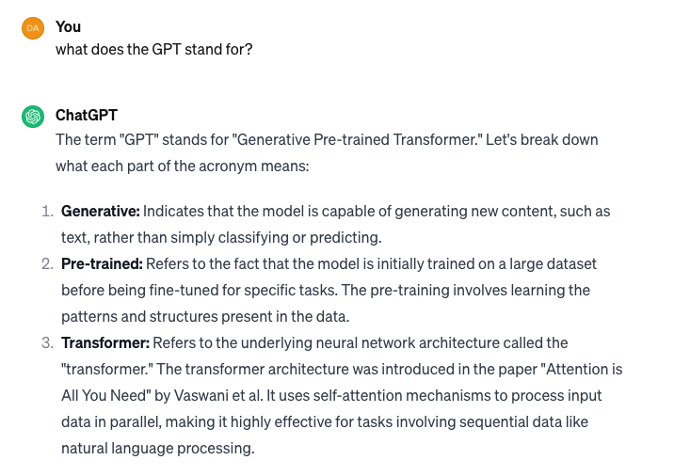
The GPT

Slide 5
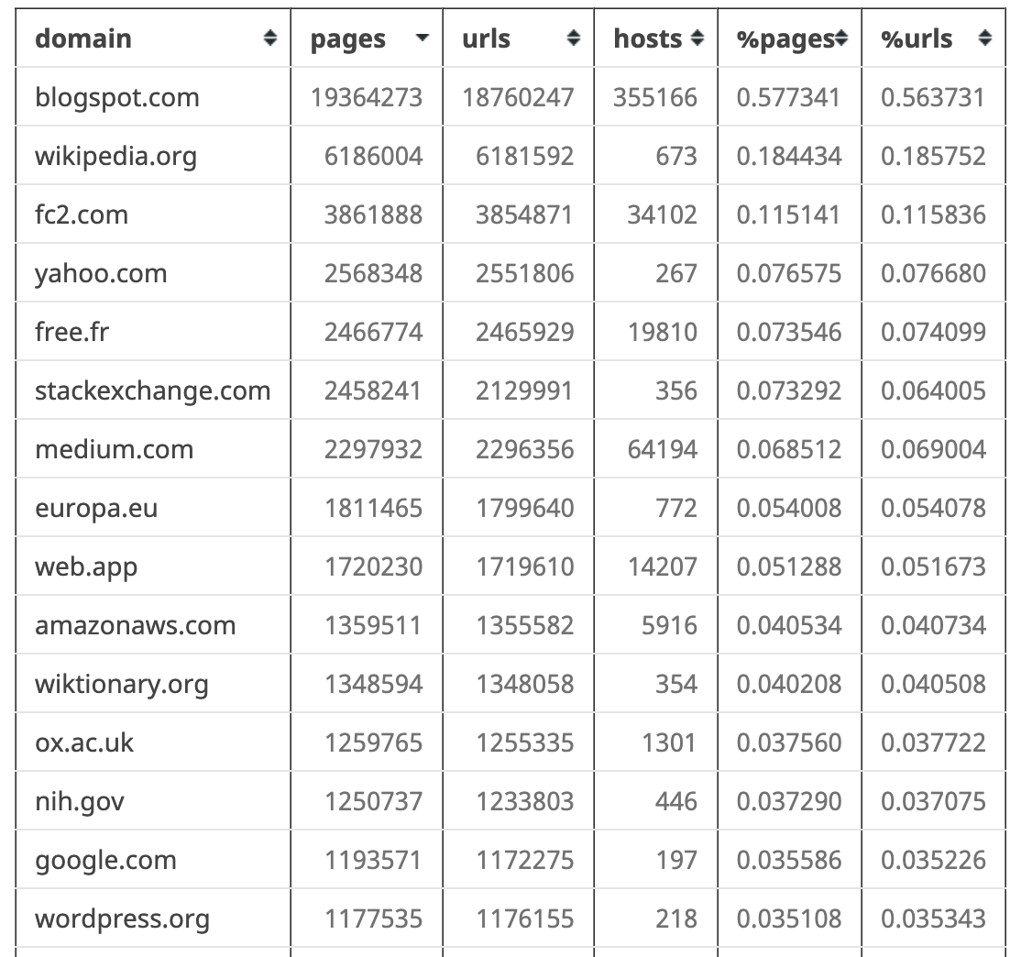
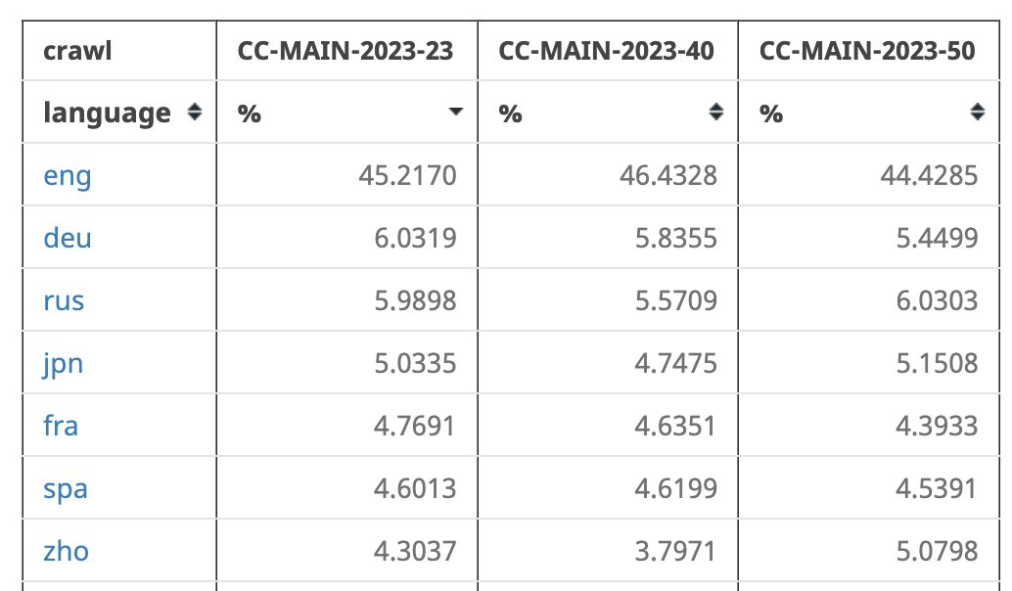
What is it trained on?
Common Crawl (https://commoncrawl.org) – open source dataset of the internet > 120 TB

Slide 6
Training and Output Generation
Also books, news articles (see NYT lawsuit)
The following is from asking chatGPT
Text converted to tokenized input sequence
Add positional information (records token order)
Multi-head self attention (weighting)
Normalization / Feedforward / Layer Normalization
Generating Responses
Starts with the prompt
Language Understanding Component – convert to input sequence
Generate and score possible responses, use chat history

Slide 7
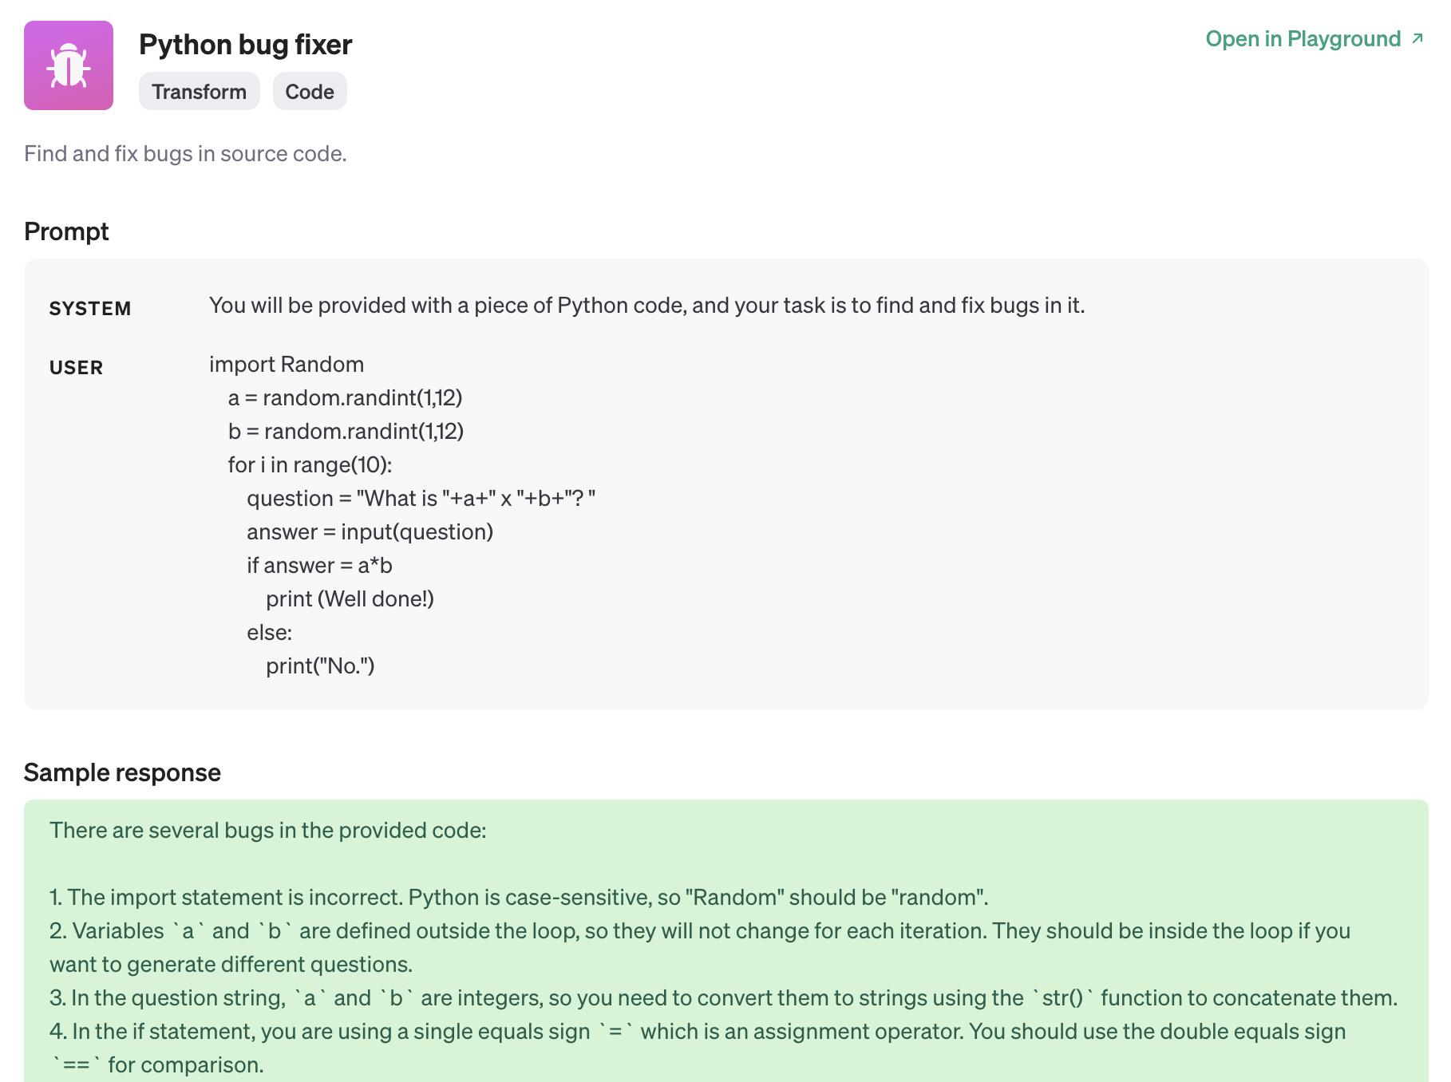
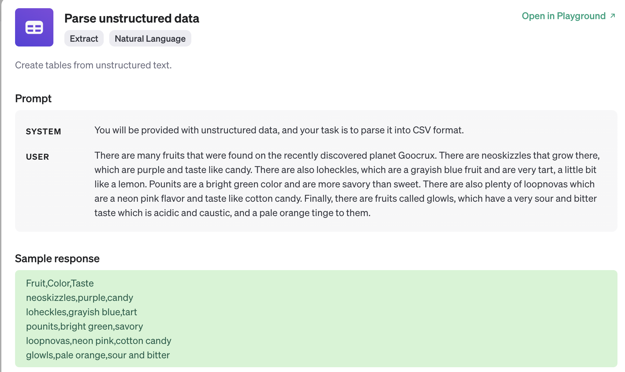
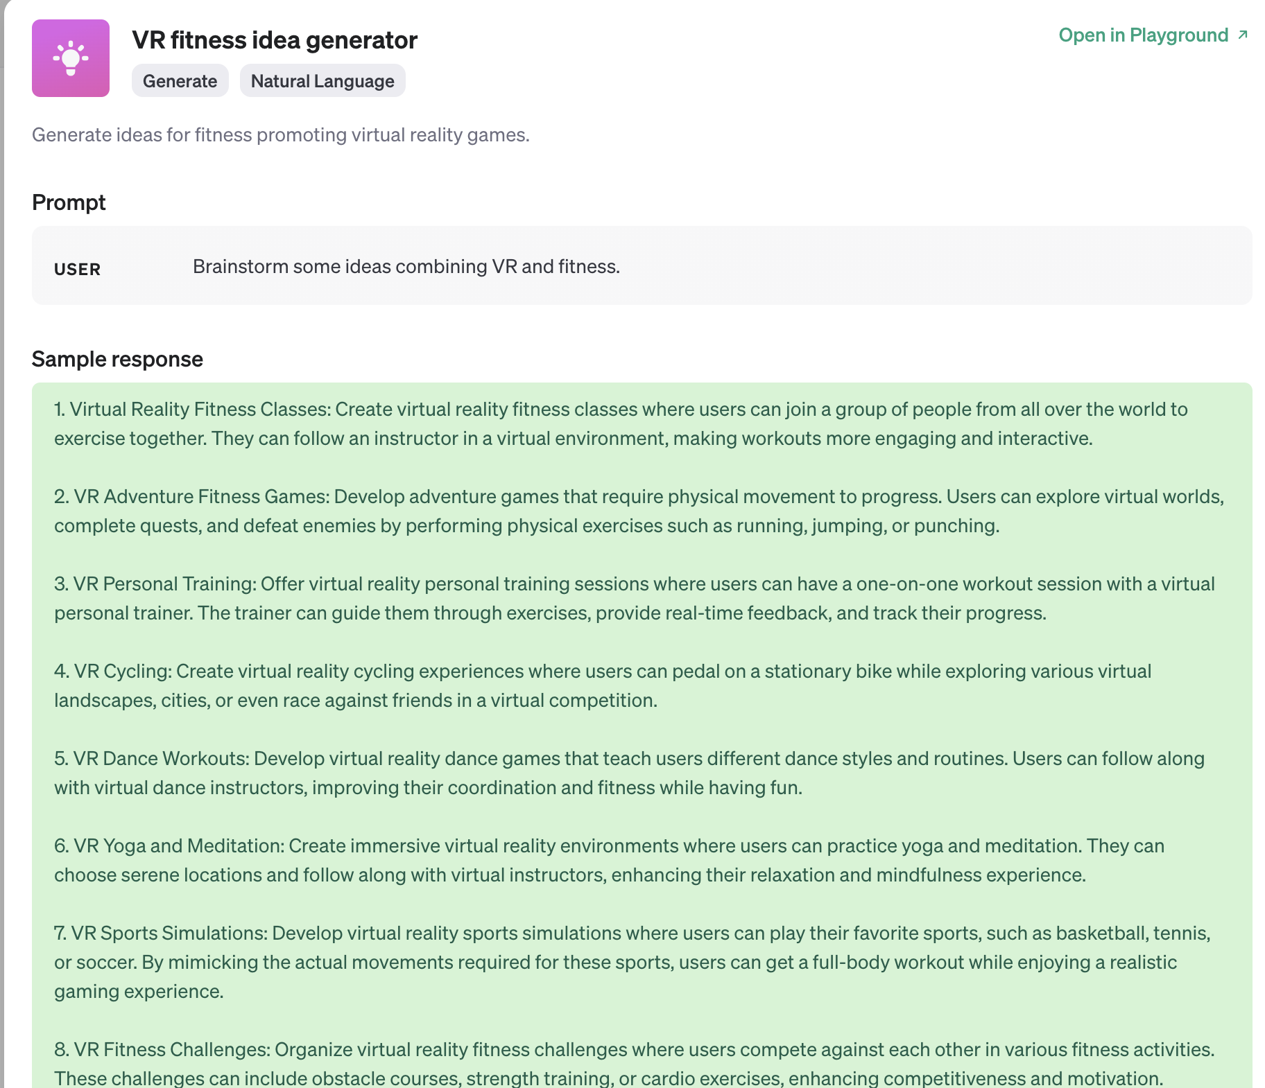
The prompt
https://platform.openai.com/docs/examples

Slide 8
https://platform.openai.com/docs/guides/prompt-engineering
Tactic: Include details in your query to get more relevant answers
In order to get a highly relevant response, make sure that requests provide any important details or context. Otherwise you are leaving it up to the model to guess what you mean.
Worse | Better
How do I add numbers in Excel? | How do I add up a row of dollar amounts in Excel? I want to do this automatically for a whole sheet of rows with all the totals ending up on the right in a column called "Total".
Who’s president? | Who was the president of Mexico in 2021, and how frequently are elections held?
Write code to calculate the Fibonacci sequence. | Write a TypeScript function to efficiently calculate the Fibonacci sequence. Comment the code liberally to explain what each piece does and why it's written that way.
Summarize the meeting notes. | Summarize the meeting notes in a single paragraph. Then write a markdown list of the speakers and each of their key points. Finally, list the next steps or action items suggested by the speakers, if any.

Slide 9
HALLUCINATION
Generated response is not based on fact
From OpenAI safety practices: “Understand and communicate limitations”
CHECK THE RESPONSES
TED Talk: Your brain hallucinates your conscious reality - Anil Seth

Slide 10
How does chatGPT/openAI make money?
GPT 4+: more recent trainings
Pay for API:
Text to speech
Speech to text
Image Generation
Vision (“describe this image”)
Content Moderation (rate text/images for offensive content)

Slide 11
This script is in the course repo
from openai import OpenAI
# this will fail if you haven't created your key on openai.com and store it in 'OPENAI_API_KEY.txt'
with open('OPENAI_API_KEY.txt') as api_key:
os.environ['OPENAI_API_KEY'] = api_key.read()
client = OpenAI()
if len(sys.argv) > 1:
input = sys.argv[1]
else:
input = "you're a jolly roger!"
response = client.moderations.create(
model="omni-moderation-latest",
input=input)
# parse response (not shown)

Slide 12
Moderation: You’re a jolly roger
0.0059 harassment False
0.0008 harassment_threatening False
0.0001 hate False
0.0000 hate_threatening False
0.0000 illicit False
0.0000 illicit_violent False
0.0000 self_harm False
0.0000 self_harm_instructions False
0.0000 self_harm_intent False
0.0000 sexual False
0.0000 sexual_minors False
0.0012 violence False
0.0000 violence_graphic False
0.0008 harassment/threatening False
0.0000 hate/threatening False
0.0000 illicit/violent False
0.0000 self-harm/intent False
0.0000 self-harm/instructions False
0.0000 self-harm False
0.0000 sexual/minors False
0.0000 violence/graphic False
Pretty safe. What even is a jolly roger?

Slide 13
Moderation: I’m killing myself with burritos
0.0008 harassment False
0.0010 harassment_threatening False
0.0000 hate False
0.0000 hate_threatening False
0.0053 illicit False
0.0001 illicit_violent False
0.8562 self_harm True
0.0005 self_harm_instructions False
0.7272 self_harm_intent True
0.0001 sexual False
0.0000 sexual_minors False
0.4501 violence True
0.0025 violence_graphic False
0.0010 harassment/threatening False
0.0000 hate/threatening False
0.0001 illicit/violent False
0.7272 self-harm/intent True
0.0005 self-harm/instructions False
0.8562 self-harm True
0.0000 sexual/minors False
0.0025 violence/graphic False
harassment False 0.0002
harassment/threatening False 0.0004
harassment_threatening False 0.0004
hate False 5.939e-07
hate/threatening False 2.640e-07
hate_threatening False 2.640e-07
self-harm True 0.9130
self-harm/instructions False 3.578e-07
self-harm/intent True 0.9423
self_harm True 0.9130
self_harm_instructions False 3.578e-07
self_harm_intent True 0.9423
sexual False 8.066e-05
sexual/minors False 3.134e-07
sexual_minors False 3.134e-07
violence False 0.0563
violence/graphic False 0.0004
violence_graphic False 0.0004
Flagged? True
Last year:
This year:

Slide 14
Moderation: I hate pancakes
0.0062 harassment False
0.0000 harassment_threatening False
0.0000 hate False
0.0000 hate_threatening False
0.0000 illicit False
0.0000 illicit_violent False
0.0005 self_harm False
0.0000 self_harm_instructions False
0.0002 self_harm_intent False
0.0000 sexual False
0.0000 sexual_minors False
0.0005 violence False
0.0000 violence_graphic False
0.0000 harassment/threatening False
0.0000 hate/threatening False
0.0000 illicit/violent False
0.0002 self-harm/intent False
0.0000 self-harm/instructions False
0.0005 self-harm False
0.0000 sexual/minors False
0.0000 violence/graphic False
“I hate pancakes” Just stating a food preference.

Slide 15
Moderation: You are a pancake
0.1081 harassment False
0.0011 harassment_threatening False
0.0001 hate False
0.0000 hate_threatening False
0.0000 illicit False
0.0000 illicit_violent False
0.0074 self_harm False
0.0002 self_harm_instructions False
0.0003 self_harm_intent False
0.0001 sexual False
0.0000 sexual_minors False
0.0228 violence False
0.0016 violence_graphic False
0.0011 harassment/threatening False
0.0000 hate/threatening False
0.0000 illicit/violent False
0.0003 self-harm/intent False
0.0002 self-harm/instructions False
0.0074 self-harm False
0.0000 sexual/minors False
0.0016 violence/graphic False
“You are a pancake.” Not obviously bad.

Slide 16
Moderation: I hate pancakes; you are a pancake
0.6482 harassment True
0.0000 harassment_threatening False
0.0072 hate False
0.0000 hate_threatening False
0.0000 illicit False
0.0000 illicit_violent False
0.0005 self_harm False
0.0002 self_harm_instructions False
0.0002 self_harm_intent False
0.0000 sexual False
0.0000 sexual_minors False
0.0005 violence False
0.0000 violence_graphic False
0.0000 harassment/threatening False
0.0000 hate/threatening False
0.0000 illicit/violent False
0.0002 self-harm/intent False
0.0002 self-harm/instructions False
0.0005 self-harm False
0.0000 sexual/minors False
0.0000 violence/graphic False
Ooh, I went TOO FAR

Slide 17
Moderation: You are a pancake. By the way, I hate pancakes.
0.2529 harassment False
0.0009 harassment_threatening False
0.0073 hate False
0.0000 hate_threatening False
0.0000 illicit False
0.0000 illicit_violent False
0.0006 self_harm False
0.0002 self_harm_instructions False
0.0002 self_harm_intent False
0.0000 sexual False
0.0000 sexual_minors False
0.0101 violence False
0.0000 violence_graphic False
0.0009 harassment/threatening False
0.0000 hate/threatening False
0.0000 illicit/violent False
0.0002 self-harm/intent False
0.0002 self-harm/instructions False
0.0006 self-harm False
0.0000 sexual/minors False
0.0000 violence/graphic False
Not as bad for some reason

Slide 18
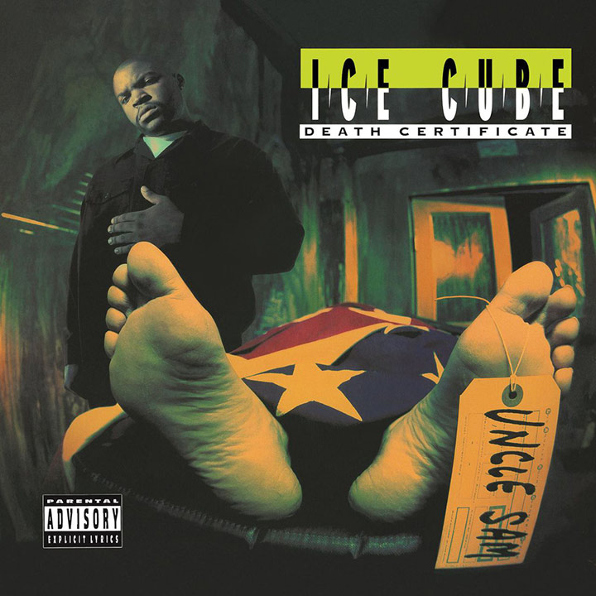
Moderation: Image urls (controversial album covers)
0.0000 harassment False
0.0000 harassment_threatening False
0.0000 hate False
0.0000 hate_threatening False
0.0000 illicit False
0.0000 illicit_violent False
0.0797 self_harm False
0.0002 self_harm_instructions False
0.0003 self_harm_intent False
0.0007 sexual False
0.0000 sexual_minors False
0.4227 violence True
0.1453 violence_graphic False
0.0000 harassment/threatening False
0.0000 hate/threatening False
0.0000 illicit/violent False
0.0003 self-harm/intent False
0.0002 self-harm/instructions False
0.0797 self-harm False
0.0000 sexual/minors False
0.1453 violence/graphic False

Slide 19
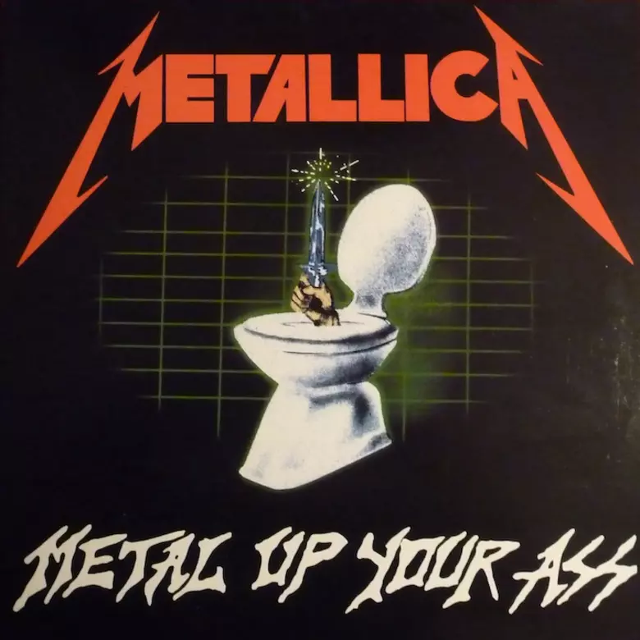
Moderation: Image urls (controversial album covers)
0.0000 harassment False
0.0000 harassment_threatening False
0.0000 hate False
0.0000 hate_threatening False
0.0000 illicit False
0.0000 illicit_violent False
0.0185 self_harm False
0.0004 self_harm_instructions False
0.0003 self_harm_intent False
0.2058 sexual False
0.0000 sexual_minors False
0.1245 violence False
0.0164 violence_graphic False
0.0000 harassment/threatening False
0.0000 hate/threatening False
0.0000 illicit/violent False
0.0003 self-harm/intent False
0.0004 self-harm/instructions False
0.0185 self-harm False
0.0000 sexual/minors False
0.0164 violence/graphic False

Slide 20
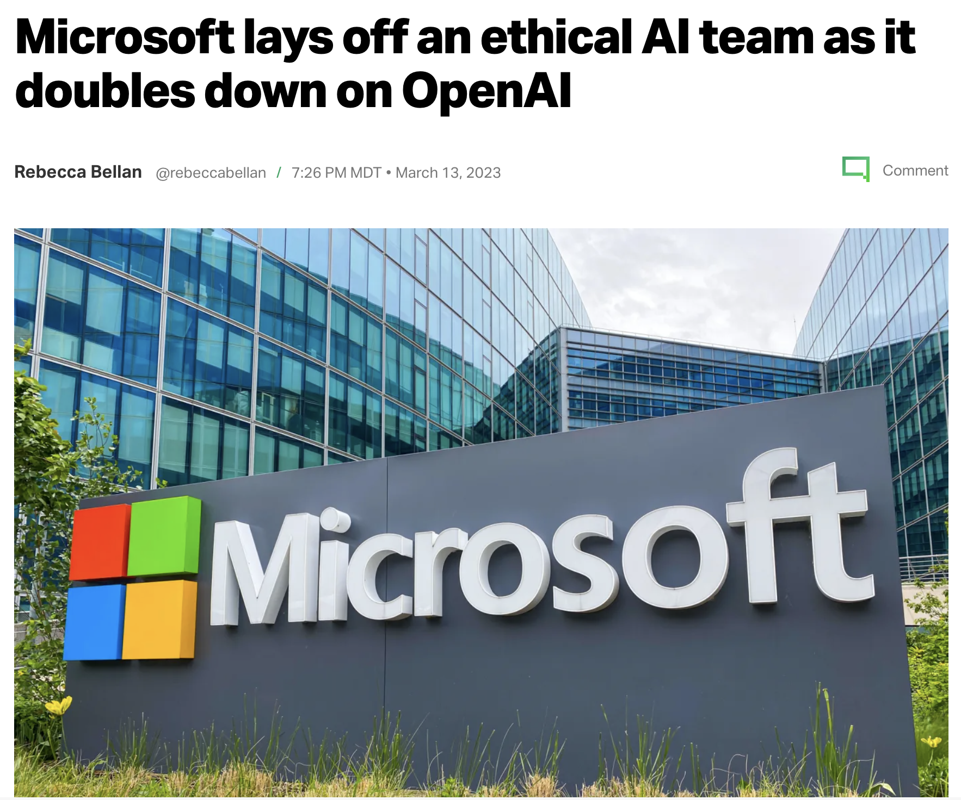
Ethical issues
-www.techcrunch.com

Slide 21
Ethical Issues
Plagiarism
Copyright violation
Replacing a human writer, graphic designer, … researcher?
Using it as a crutch

Slide 22
Ethical issues: replacing a human
Using AI instead of paying a professional
Agreement from Writers strike
“studios ‘cannot use AI to write scripts or to edit scripts that have already been written by a writer’”
“prevents studios from treating AI-generated content as ‘source material’” [then] adapt for a lower fee and less credit than a fully original script.”
Graphic Design
DALL-E
Adobe Firefly
Adobe Illustrator
The Guardian. (2023, October 1). Hollywood writers strike over artificial intelligence. http://tinyurl.com/wga-strike

Slide 23
Ethical issues: Copyright violation
Copyright is a type of intellectual property that protects original works of authorship as soon as an author fixes the work in a tangible form of expression. - www.copyright.gov
New York Times lawsuit against openAI and Microsoft:
‘…OpenAI spits out text that matches Times articles verbatim. The Times provides 100 examples of such “regurgitation” in the lawsuit…’ – vox.com 2024
“ ‘Substitutional’ … meaning that ChatGPT and Bing have become, for some people, a substitute for the publisher’s original work.” – NPR.org Jan 24th. 2025

Slide 24
Ethical issues: Copyright vs. Fair use
Lawyers for ChatGPT claim fair use. What is “fair use”?
Allows copyrighted material to be used for things like “educational, research, or commentary purposes.”
Aside: Are scientific papers under copyright? Do we reference them with fair use?
Authors retain copyright of their research manuscripts and receive clear credit for, and ownership of their work. Generally, authors will be asked to grant non-exclusive rights to Springer Nature to publish, reproduce, copy and distribute. - https://support.nature.com/en/support/solutions/articles/6000080095-author-copyrights-information
Open Access = Creative Commons license. Allows copyright holders to retain the copyright to their works while giving the public permission to use those works under certain conditions. … in order to grant a CC license to a work you must hold the copyright. - https://copyright.psu.edu/copyright-basics/creative-commons/
Npr.org. (2025, Jan 24). ‘The New York Times’ takes OpenAI to court. ChatGPT’s future could be on the line. https://tinyurl.com/Nprchatgpt

Slide 25
Ethical Issues: Plagiarism
Passing AI off as your own work
Misrepresents your qualifications
Misrepresents your sincerity
Violates academic integrity

Slide 26
Exercises

Slide 27
Exercise: Create 3 dialogs from examples
https://platform.openai.com/docs/examples
Choose an example prompt, then
copy/paste it into your own, new chat,
Make changes to what you’re requesting
Give it new data (make changes yourself, or find some more)
Record the chat dialog using “share->create link”
Do 3 of these, each from a different category of the examples: Extract/Generate/Transform/Code/Natural Language/Structured Data
Example. Create a dialog with a Code, a Generate, and an Extract example.

Slide 28
Exercise: learn R/RStudio
Have a dialog with chatGPT to learn R/RStudio. Share chat link at the end.
Start a new chat
Prompt: I want to learn the program RStudio and am new to it
Ask questions about R or RStudio. Ask it to produce exercises for you. Learn at your own pace and follow your curiosity.
Note: If you are proficient with RStudio, try something else: e.g. VSCode.
Turn in: a link to your chat
Answer questions
Question: Are the instructions working/valid?
Question: What is good about this method of learning? What doesn’t work?

